Slide 1
Australia’s
History
The Impact of European
Exploration & Colonization

Slide 2
Teachers
Print off the following page for each student. They should complete the chart while discussing the presentation.

Slide 3
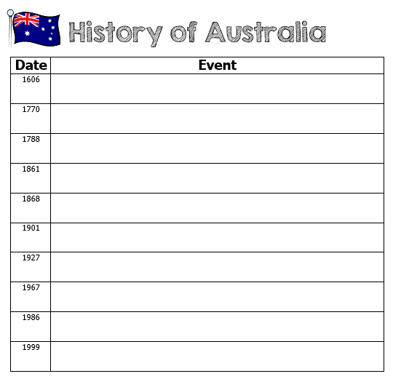

Slide 4
Australia’s
History
The Impact of European
Exploration & Colonization

Slide 5
European Exploration
First Europeans to sail to Australia were the Dutch (Netherlands) in 1606, but they didn’t settle there.
The Dutch made one landing, were attacked by Aborigines, and then abandoned further exploration.

Slide 6
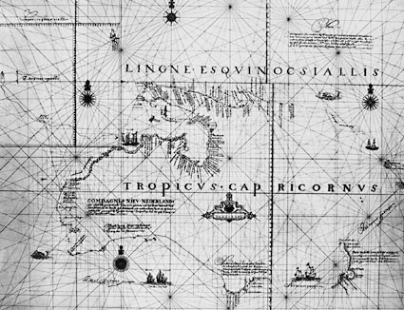
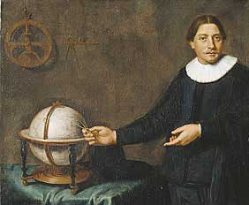

Slide 7
European Exploration
In 1770, Captain James Cook sailed around Australia.
Cook named the area “New South Wales”.
He ignored the Aborigines living there & claimed the land for England.
Sailors also mapped the coast of eastern Australia & Tasmania.

Slide 8
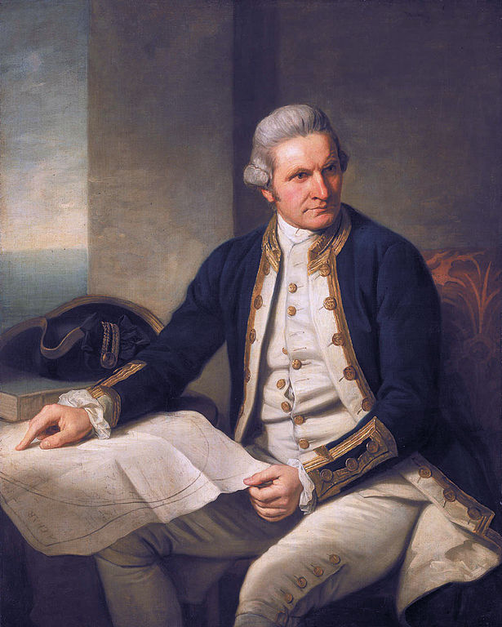

Slide 9
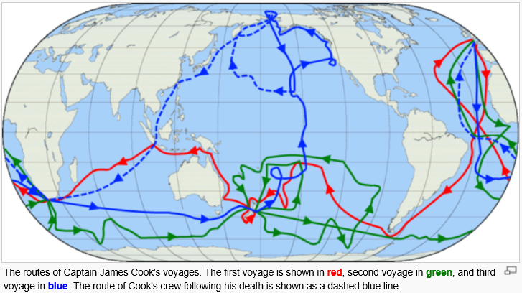

Slide 10
Prisoners as Colonists
The American Revolution forced the British to stop sending prisoners to Georgia (used as a penal colony at the time).
Great Britain had to start looking for another place to send its prisoners…
Australia seemed like a good choice: no chance of escape, no colonies around it, and very few indigenous people lived there.

Slide 11
Penal Colony
In 1787, British ships called the “First Fleet” left England with convicts to establish a prison colony.
In 1788, British prisoners settled in Australia.

Slide 12
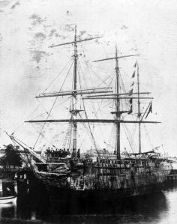
First Fleet – One of 11 Ships

Slide 13
New South Wales
From 1788 to 1832, New South Wales was officially a penal (prison) colony consisting mainly of convicts, marines (guards), and the marines’ families.
Only 20% of the first convicts were women.
The British transported prisoners to Australia until 1868.
By this time, many free immigrants were also settling there.
They built businesses, trading posts, farms, etc.

Slide 14
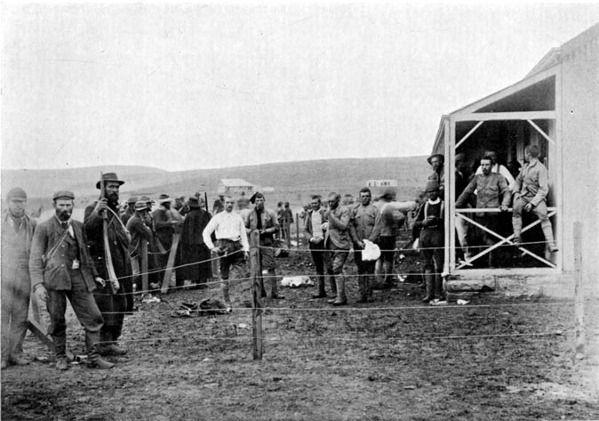

Slide 15
Port Arthur, Tasmania
From 1833 until the 1850s, it was the destination for the hardest of convicted British and Irish criminals--those who were secondary offenders having re-offended after their arrival in Australia.
In addition, Port Arthur had some of the strictest security measures of the British penal system.
Some tales suggest that prisoners committed murder (an offense punishable by death) just to escape the desolation of life at the camp.
The Island of the Dead was the destination for all who died inside the prison camps.

Slide 16
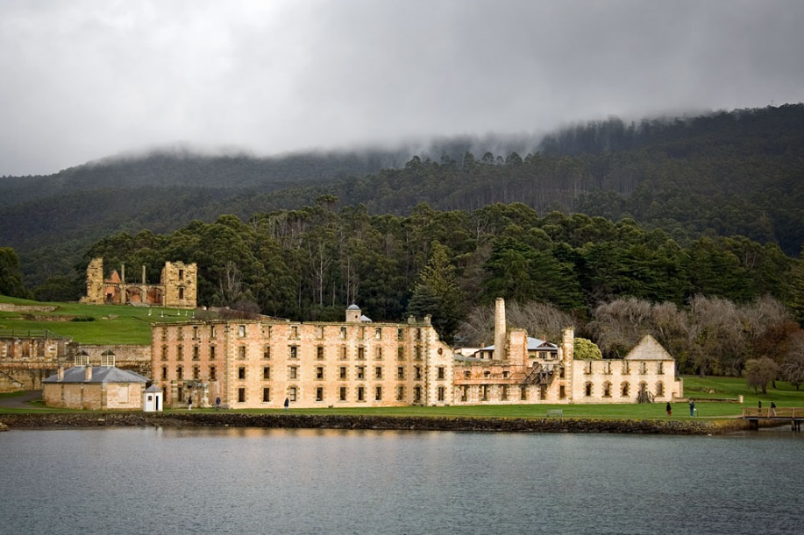

Slide 17
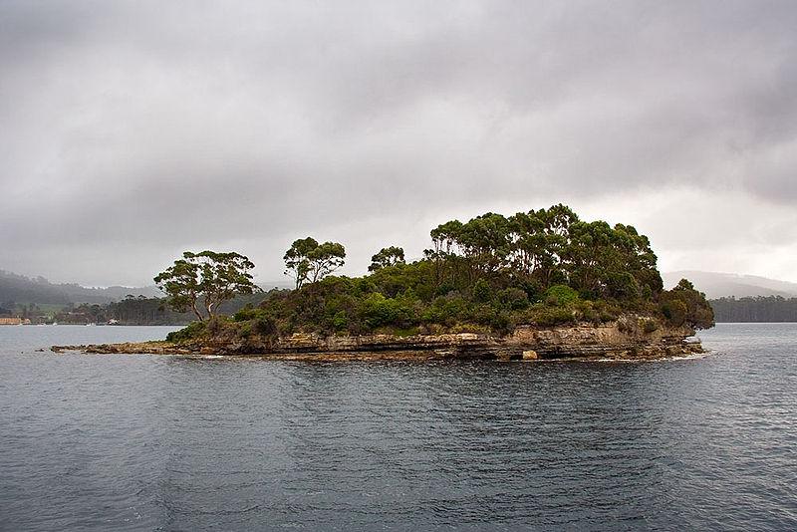
Island of the Dead

Slide 18
The Perfect Colony
Great Britain saw that Australia was a good location to base its navy in the South Pacific Ocean.
Its location would make it possible for British ships to make repairs & get supplies.
Australia also had many opportunities for trade with Asia and the Americas.

Slide 19
Commonwealth of Australia
Non-prisoner colonization continued…
The major coastal settlements soon became 7 independent colonies.
In 1861, government officials created boundaries for the colonies that are still in place today.
On January 1, 1901, the Commonwealth of Australia was established.
Melbourne served as the national capital until Canberra was completed in 1927

Slide 20
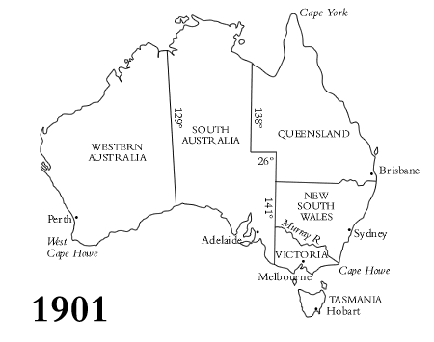

Slide 21
“White Australia”
Originally, Australia promoted a policy called “White Australia”.
They would not allow non-Caucasians to immigrate to Australia.
That has since changed…
Immigration Restriction Act of 1901: restricted migration to people primarily of European descent
This was dismantled after World War II.
Today, Australia has a global, non-discriminatory policy and is home to people from more than 200 countries.

Slide 22
Aborigines
Aborigines are the native people of Australia.
They have gone through stages of being conquered and having their lands taken.
European settlers often separated Aborigines from society.
Some were removed from their families and placed into institutions.
Others were killed because they were seen as a “nuisance”.

Slide 23
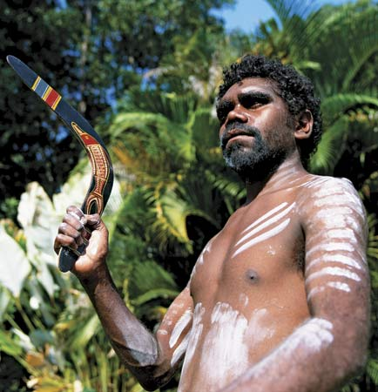

Slide 24
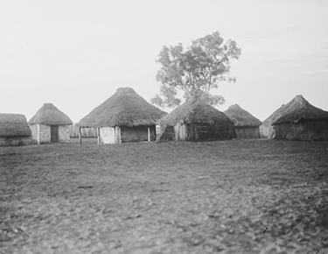
Aboriginal Dwellings - 1923

Slide 25
Aborigines
In the 1830s, remnants of the tribes in the settled areas were moved onto reserves.
They were forbidden from teaching their children their own language and customs.
During the 1900s, separation was an official government policy which lasted for many decades.
Today, many Aboriginal people do not know their origins: which tribe they are descended from or the names of their parents and or grandparents.
They are a lost generation.

Slide 26
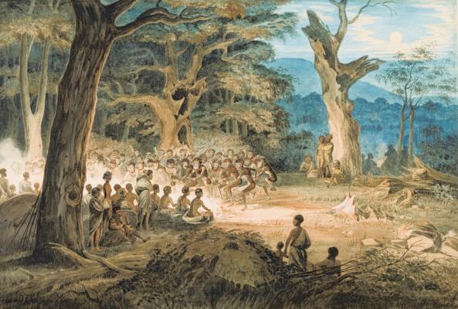

Slide 27
Aborigines
In 1967: Australia’s federal government began to pass legislation to help the Aborigines.
It was widely seen as affirmation of the Australian people’s wish to see its government take direct action to improve the living conditions of Aborigines.
In that same year, striking Aboriginal farmers changed political history by extending a demand for equal wages to a declaration of their rights of ownership of traditional lands.
This became one of Australia’s first successful land claims by its indigenous people.

Slide 28
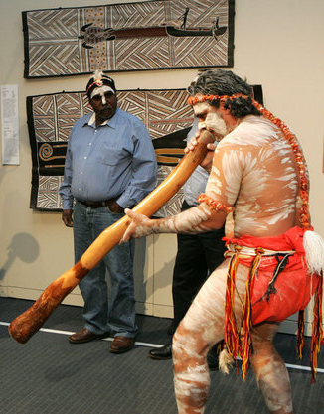

Slide 29
Australia Today
In 1986, the Australia Act severed all legal ties with the British Empire.
Today, Australia is a parliamentary democracy (constitutional monarchy) with Elizabeth II as queen.
1999: 55% of voters rejected the idea of becoming an independent republic.

Slide 30
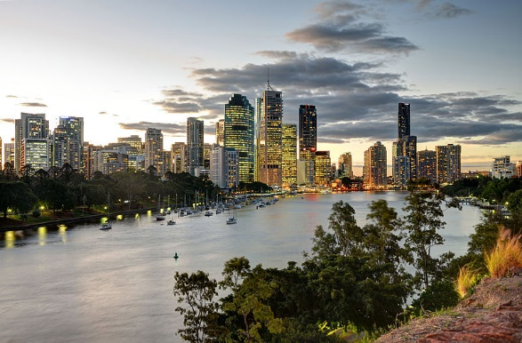
Brisbane

Slide 31
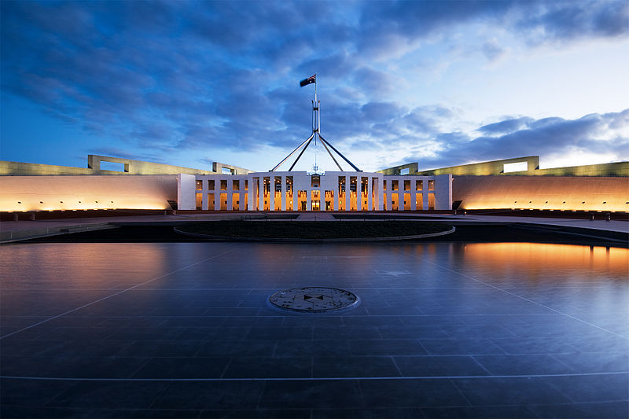
Parliament House - Canberra

Slide 32
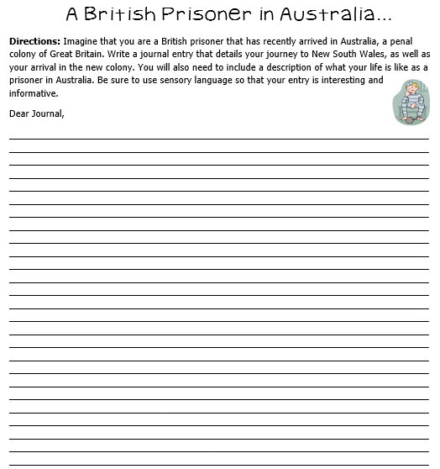

Slide 33
Teachers
Have the students use their notes to create a colorful timeline of Canada. I let the students use a sentence strip (or construction paper cut in half and taped end-to-end) to make long timelines. Sentence strips are nice because they have lines.
These make great hallway displays!

Slide 34
Timeline Project
Be sure all 10 dates are written on your timeline.
Label each event—make it short and sweet (you don’t have to use complete sentences).
Draw a simple illustration to accompany at least seven of the events.
Use thin markers or colored pencils to make your timeline colorful and creative.

Slide 35
Historical Marker
Have you ever seen a sign that marks a significant event in history? We have them all over our country, and now you get to create a marker that could be used in Australia!
Review your “Australia’s History” notes. Which event do you think is the most important event in Australia’s history? You are going to be creating a marker that will tell tourists about the significance of that event.

Slide 36
Historical Marker
Directions:
1. Choose your event and write what it is in the CIRCLE on the top of the historical marker.
2. Next, write a short description of the event.
3. Then, write a brief opinion statement on why you think that this event is important to Australia’s history.
4. At the bottom, write the place where your marker will be located.
5. Draw an illustration that symbolizes your event.

Slide 38
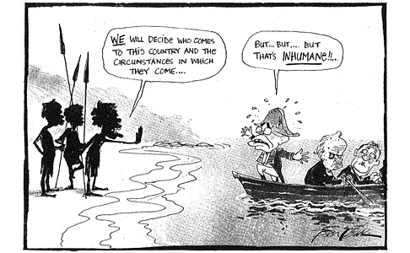

Slide 39
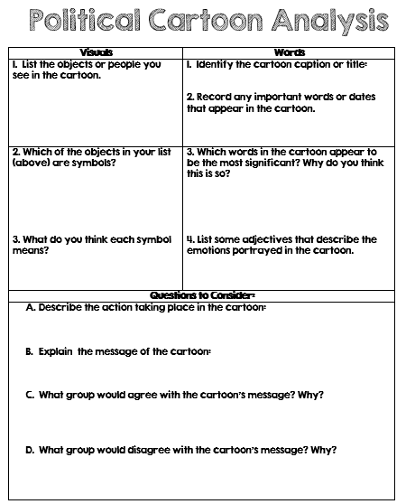

Slide 40
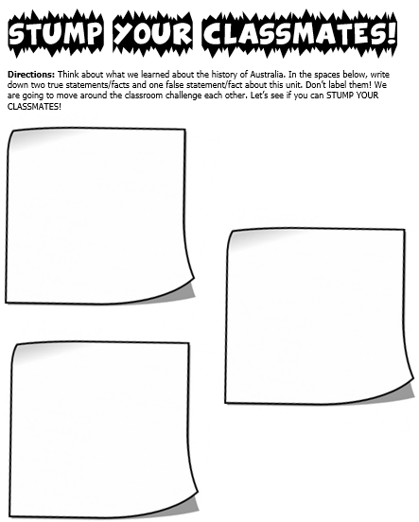

Slide 42
Teachers
Thank you for downloading this file. I hope you enjoy using it with your students, and I can’t wait to read your feedback in my TPT store! ☺
For more social studies materials, please visit my store: http://www.teacherspayteachers.com/Store/Brain-Wrinkles
I teach 6th grade Language Arts and Social Studies in Georgia, so my products are aligned with Common Core (LA) and Georgia Performance Standards (SS).
© Copyright 2013. Brain Wrinkles. All rights reserved. Permission is granted to copy pages specifically designed for student or teacher use by the original purchaser or licensee. The reproduction of any other part of this product is strictly prohibited. Copying any part of this product and placing it on the Internet in any form (even a personal/classroom website) is strictly forbidden. Doing so makes it possible for an Internet search to make the document available on the Internet, free of charge, and is a violation of the Digital Millennium Copyright Act (DMCA).

Slide 43
Australia Facts - Cool, Fun Facts about Down Under Video
https://www.youtube.com/watch?v=hJm7kLzEmdE

